Slide 1

Project Title :- OScope: Operating Systems Simulation & Experimentation Laboratory
DIV :- CSE(AI)-E
Date : 30/10/2026
Day - Friday
Presented by :-
Aditya Rana – PRN: 12413107
Nitish Sahu – PRN: 12412096
Palash Sahuji – PRN: 12414915
Manthan Sali – PRN: 12411978
Project Guide :- Prof. Priyanka Khalate
DEPARTMENT OF COMPUTER SCIENCE ENGINEERING
(ARTIFICIAL INTELLIGENCE )
VISHWAKARMA INSTITUTE OF TECHNOLOGY, PUNE

Slide 2
Overview
1. Introduction & Project Scope
2. Motivation & Problem Statement
3. Literature Survey (Pedagogical Systems & Simulators)
4. Research Gap & Comparative Analysis
5. Project Objectives & Deliverables
6. Design & 4-Tier System Architecture
7. Technical Stack & Implementation Details
8. Academic References & Citations
9. Conclusion & Project Summary

Slide 3

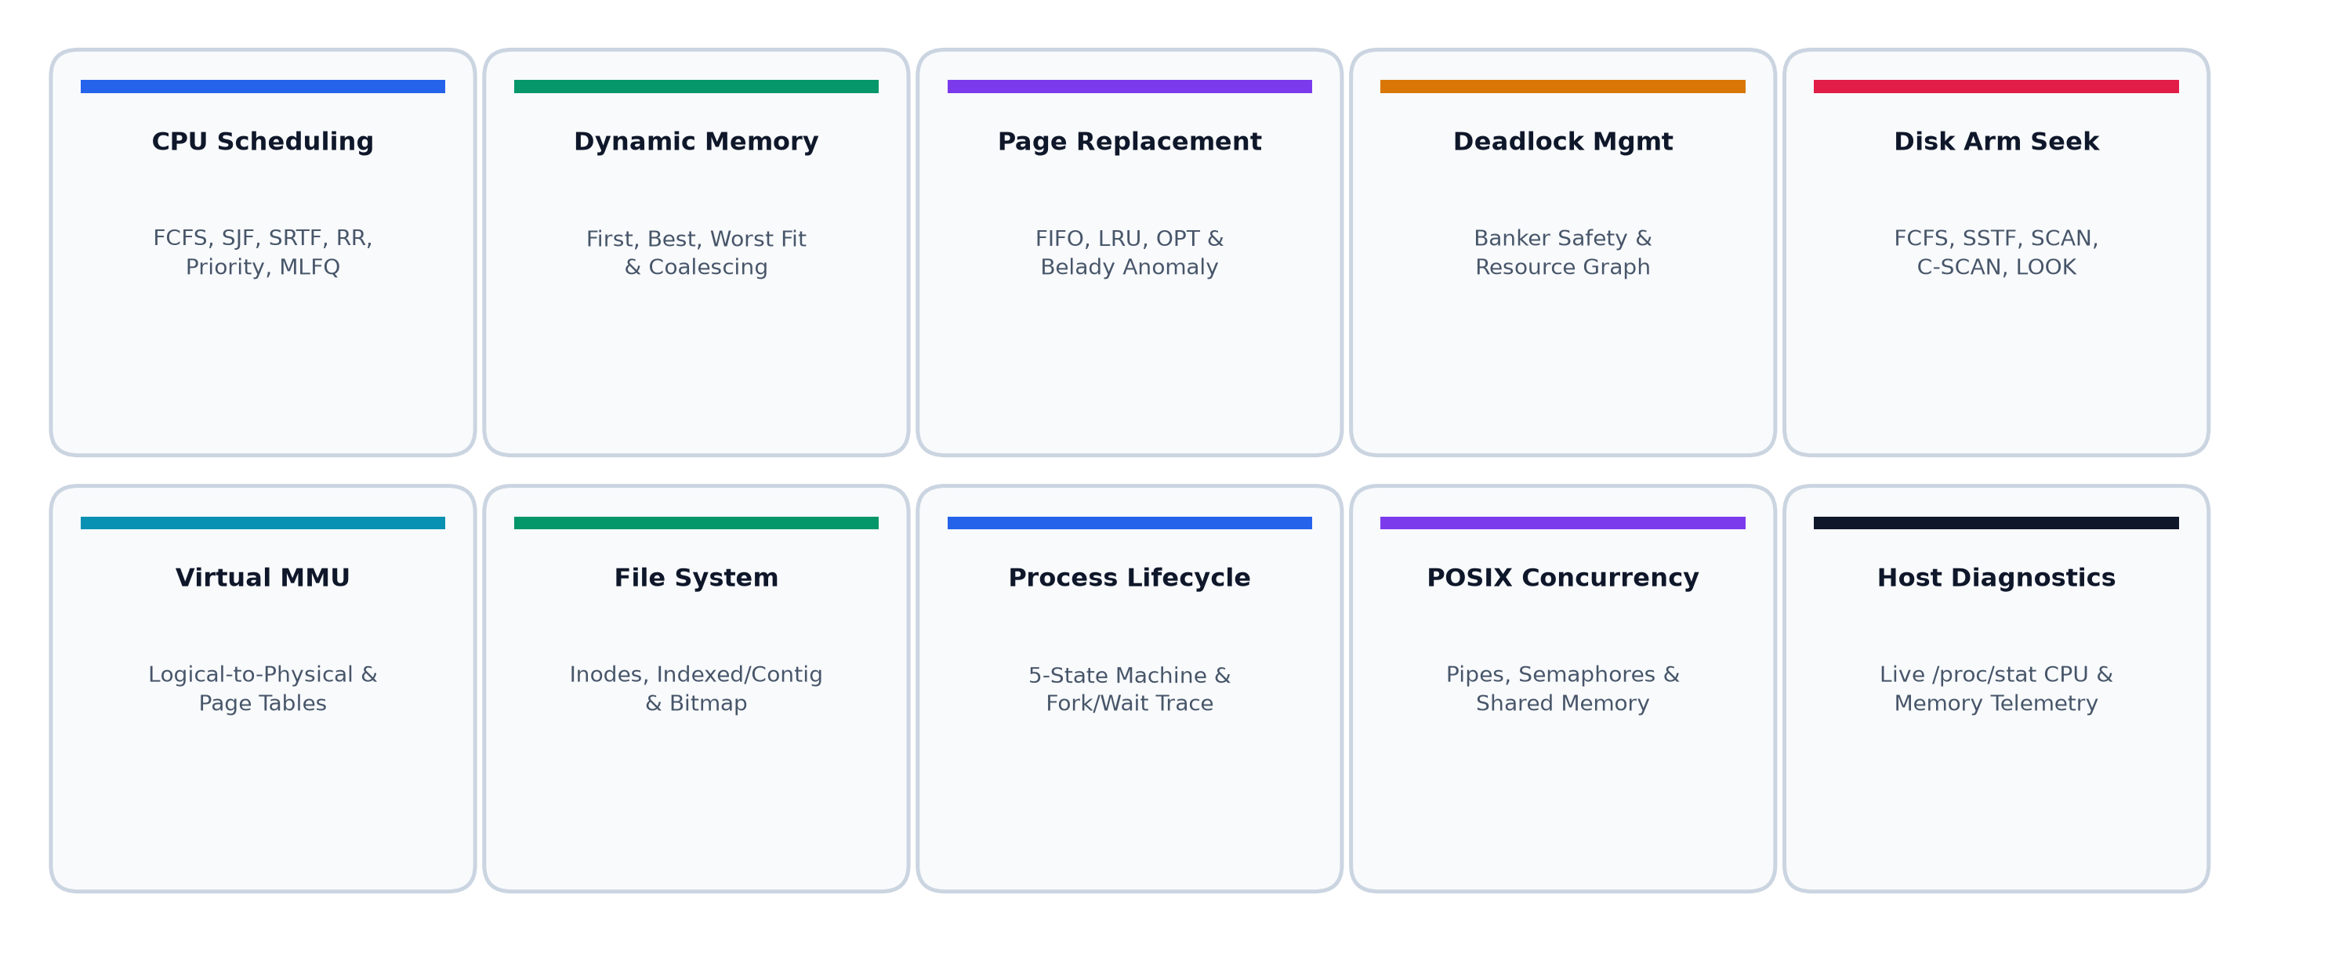
Introduction
Interactive Systems Laboratory: Connects theoretical Operating System principles with real algorithmic execution, measurement, vector visualization, and comparative benchmarks.
Bridging Abstract Theory: Eliminates black-box confusion by demystifying how CPU dispatching, dynamic memory placement, virtual paging, and deadlocks function in practice.
Dual-Pillar Architecture: Couples an authoritative C++20 simulation core with real Linux/POSIX kernel interfaces (fork/execve process trees, anonymous pipes, semaphores, and /proc telemetry).
Production-Grade Web Experience: Delivers an accessible, zero-dependency modern light-mode engineering platform inspired by Linear/Geist design guidelines across 10 distinct OS domains.

Slide 4

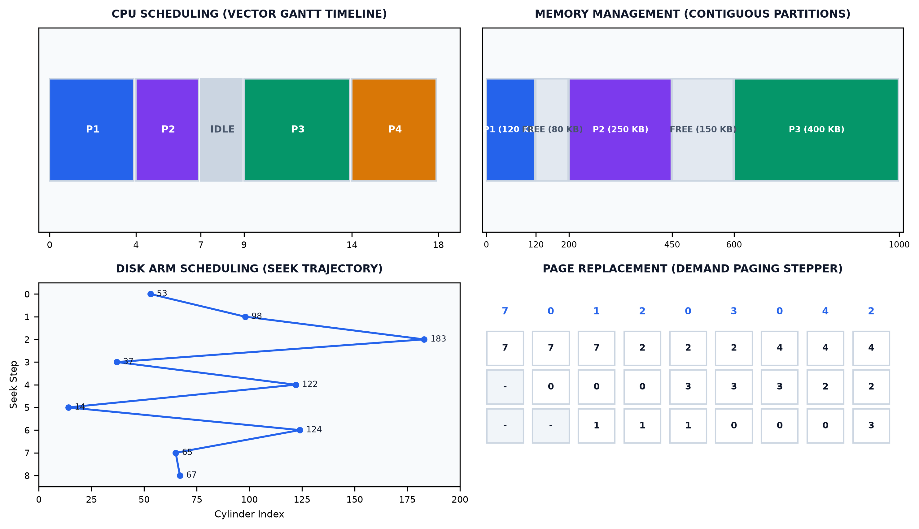
Motivation
High Cognitive Barrier: Abstract kernel concepts (address translation, multi-queue preemption, Belady's anomaly) are hidden in kernel space and difficult to grasp from static textbook diagrams.
Severe Tool Fragmentation: Students are forced to switch between disconnected, single-topic CLI programs or abandoned 2000s Java applets with no unified workflow.
Lack of Empirical Verification: Inability to systematically test and benchmark edge cases (convoy effects, priority inversions, memory fragmentation, and safe vs unsafe state sequences).
Active Learning Methodology: Addresses the proven pedagogical pipeline: Learn -> Configure Workloads -> Execute C++ Simulation -> Observe Vector Visualizers -> Measure Metrics -> Analyze.

Slide 5

Objective
Unified 10-Module Suite: Build a comprehensive laboratory covering CPU Scheduling, Dynamic Memory, Page Replacement, Banker's Deadlock Avoidance, Disk Arm Seek, Virtual Memory MMU, File Systems, Process Lifecycle, POSIX Concurrency, and Host Telemetry.
High-Precision Vector Visualizers: Implement native SVG rendering for Gantt charts with millisecond guidelines, memory maps with fragmentation analysis, step-by-step frame steppers, and cylinder seek plots.
Authoritative C++ Core & Deterministic Benchmarking: Connect simulations to a compiled C++20 engine verified by 356 GoogleTests, providing reproducible textbook presets (Belady's anomaly, convoy effect, safe sequence).
Dual Modern Interface: Deliver a zero-dependency light-mode web application and a native PySide6 desktop GUI with 150 automated end-to-end pytest tests.

Slide 6
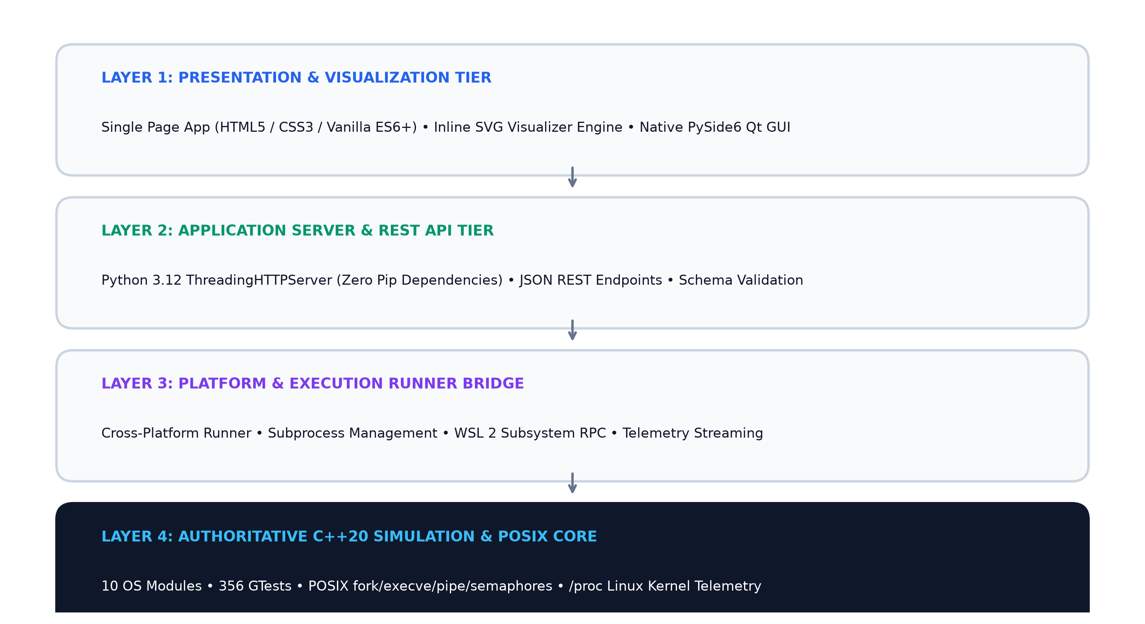
System Architecture
Tier 1 (Presentation Layer): Modern Light-Mode Single Page Application (HTML5 / CSS3 / Vanilla ES6+) + Native PySide6 (Qt 6) Desktop GUI. Features custom inline SVG stroke icons.
Tier 2 (Application & REST API Layer): Python 3.12 Multi-Threaded HTTP Server (ThreadingHTTPServer) with zero external pip dependencies routing JSON endpoints (/api/*/run).
Tier 3 (Platform Execution Bridge): Automated environment runner supporting native Linux and Windows WSL 2 (wsl.exe), handling CLI argument marshaling and telemetry streaming.
Tier 4 (Authoritative Simulation Core): Compiled C++20 engine executing deterministic algorithms, real POSIX system calls (fork, execve, pipe, sem_t), and /proc parser.

Slide 7
Tech Stack
Core Simulation Engine: C++20 (Modern ISO C++), CMake 3.20+, GoogleTest (356 unit tests), POSIX APIs (<unistd.h>, <semaphore.h>).
Backend & API Server: Python 3.12 Standard Library (http.server.ThreadingHTTPServer - zero external pip dependencies), Subprocess / WSL 2 execution runner.
Modern Web Frontend: Vanilla JavaScript (ES6+), HTML5, CSS3 Custom Properties (Linear/Geist Light Mode Design System), Vector SVG Engine (Lucide-standard icons).
Desktop GUI & Testing: PySide6 (Qt 6), Pytest 9.2 (150 automated tests), GitHub Actions CI pipeline.

Slide 8
References
Silberschatz, A., Galvin, P. B., & Gagne, G. (2021). Operating System Concepts (10th ed.). John Wiley & Sons.
Tanenbaum, A. S., & Bos, H. (2023). Modern Operating Systems (5th ed.). Pearson Education.
Al-Kharabsheh, K. et al. (2022). "Evaluating Interactive Visual Simulators for Operating Systems Education." IEEE Transactions on Learning Technologies, 15(3), 340-352.
Robbins, K. A., & Robbins, S. (2020). "Practical UNIX and Systems Programming Visualization." ACM Technical Symposium on Computer Science Education (SIGCSE), 52(1), 112-118.
Love, R. (2018). Linux Kernel Development (3rd ed.). Addison-Wesley Professional.

Slide 9
Conclusion
Comprehensive Integration: Successfully unified 10 core Operating Systems domains into a single production-quality laboratory platform.
Pedagogical Impact: Bridges abstract theoretical textbook models with concrete visual execution, enabling intuitive experimentation for CS students.
Engineering Rigor: Combines high-performance C++20 simulation accuracy with real POSIX kernel integration and 150 automated verification tests.
Accessible Deployment: Zero external pip dependencies, instant browser launch, and modern light-theme devtool ergonomics.

